Slide 1
Computer and Operating Systems Overview Session 1
Course : COMP6153
Effective Period : September 2018

Slide 2
Sub Topics
Basic Elements
Instruction Cycle
Interrupt
Memory
Operating System Objective
Operating System Services
Operating System as Resource Manager
Evolution of Operating System
Major Advances in the development of Modern Operating System
System Calls

Slide 3
These slides have been adapted from: Stallings, W. (2011). Operating Systems: Internals and Design Principles. 8^{th.} ISBN: 978-0-13-380591-8 Chapter 1 and 2
Acknowledgement

Slide 4
Learning Objectives
At the end of this lecture, students are able to:
LO1: Describe the basic elements of a computer system and their interrelationship
LO1: Describe the computer Instruction Cycle
LO2: Describe the concepts of Interrupts, Memory Management and I/O types and relate to current design of O/S

Slide 5
Basic Elements in a Computer System
Processor
Main Memory
referred to as real memory or primary memory
volatile
I/O modules
secondary memory devices
communications equipment
terminals
System bus
communication among processors, memory, and I/O modules

Slide 6
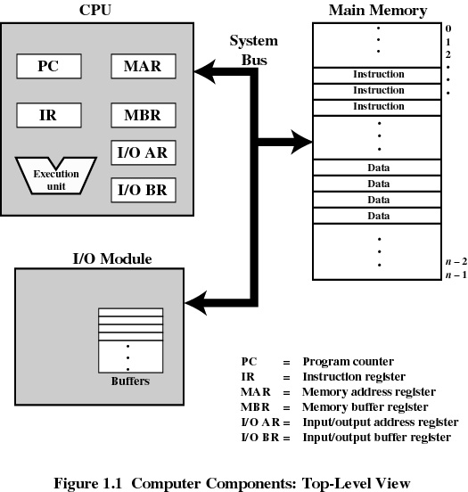
Computer Architecture (1)

Slide 7
Computer Architecture (2)
The program counter (PC) keeps track of where to find the next instruction so that a copy of the instruction can be placed in the current instruction register (IR)
The current instruction register holds the instruction that is to be executed.
The memory address register (MAR) is used to hold the memory address that contains either the next piece of data or an instruction that is to be used.

Slide 8
Computer Architecture (3)
The central processor contains the arithmetic-logic unit (ALU) and the control unit. The ALU is where data is processed.
The control unit fetches instructions from memory, decodes them and synchronizes the operations before sending signals to other parts of the computer.
The accumulator is in the arithmetic unit, the PC and the IR are in the control unit and the MAR and MBR are in the processor

Slide 9
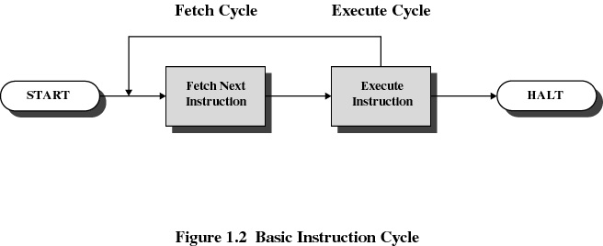
Instruction Cycle
Operating System-Internal and Design Concept - Stallings

Slide 10
Fetch and Execute (1)
The processor fetches the instruction from memory
Program counter (PC) holds address of the instruction to be fetched next
Program counter is incremented after each fetch

Slide 11
Fetch and Execute (2)
Fetched instruction is placed in the instruction register
Types of instructions
Processor-memory
transfer data between processor and memory
Processor-I/O
data transferred to or from a peripheral device
Data processing
arithmetic or logic operation on data
Control
alter sequence of execution

Slide 12
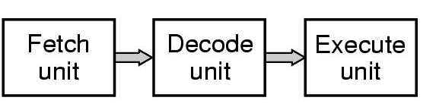
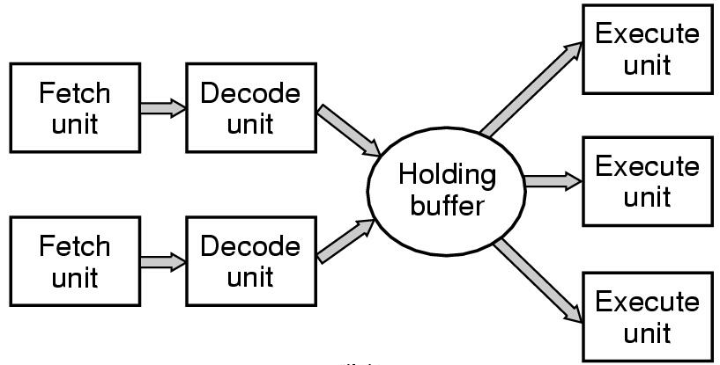
Execution Cycle
Pipelining
Superscalar

Slide 13
Interrupt
An interruption of the normal sequence of execution
Improves processing efficiency
Allows the processor to execute other instructions while an I/O operation is in progress
A suspension of a process caused by an event external to that process and performed in such a way that the process can be resumed

Slide 14
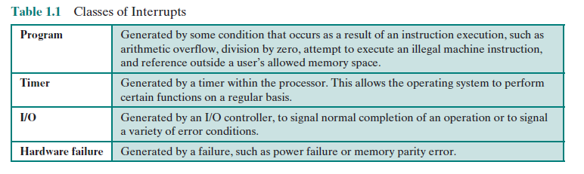
Classes of Interrupts

Slide 15
Interrupt Handler
A program that determines nature of the interrupt and performs whatever actions are needed
Control is transferred to this program
Generally part of the operating system

Slide 16
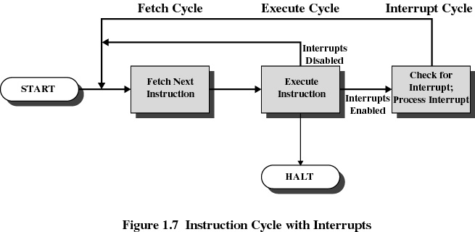
Instruction Cycle with Interrupt
Operating System-Internal and Design Concept - Stallings

Slide 17
Interrupt Cycle
Processor checks for interrupts
If no interrupts fetch the next instruction for the current program
If an interrupt is pending, suspend execution of the current program, and execute the interrupt handler

Slide 18
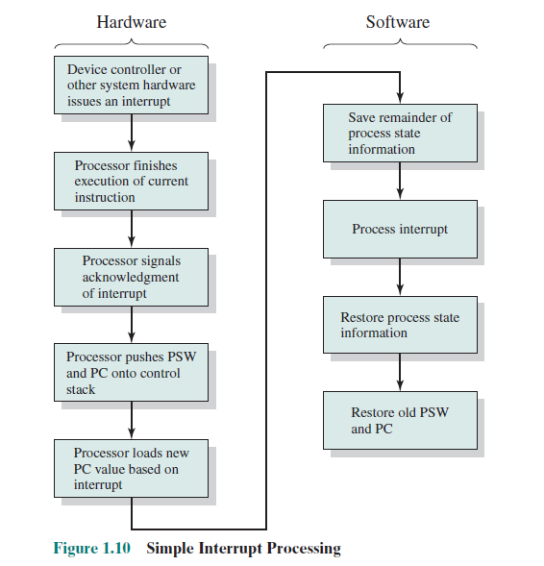
Simple Interrupt Processing

Slide 19
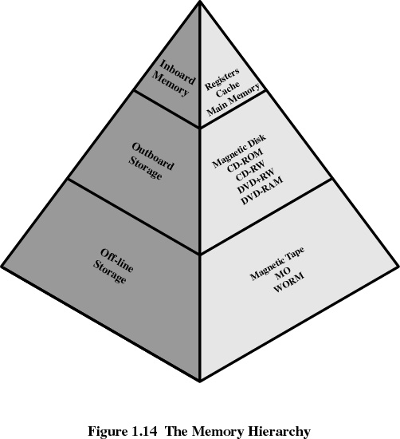
Memory Hierarchy
Highest Speed
Lowest Speed
Operating System-Internal and Design Concept - Stallings

Slide 20
Disk Cache
A portion of main memory used as a buffer to temporarily to hold data for the disk
Disk writes are clustered
Some data written out may be referenced again. The data are retrieved rapidly from the software cache instead of slowly from disk

Slide 21
Cache Memory (1)
Invisible to operating system
Increase the speed of memory
Processor speed is faster than memory speed

Slide 22
Types of Cache Memory (1)
There are generally 3 types of cache memory in modern computer systems.
L1 Cache is typically built into the architecture of the CPU. For Example the Pentium has a 16K cache. The PowerPC G5 has a 64K L1 cache. Typically L1 cache is broken down into two separate cache. One is used to hold instructions and the other to hold data. In the Sun4m architecture they are both 16kb.
L2 Cache is fast access memory (SRAM) which typically sits between the CPU and main memory. It can range between 256 - 4 Megabytes. This is typically part of the architecture.
L3 Cache is typically known as high access memory between the motherboard and CPU.

Slide 23
Operating System
What is Operating System
A program that controls the execution of application programs
An interface between applications and hardware
Objectives of Operating Systems
Convenience
Makes the computer more convenient to use
Efficiency
Allows computer system resources to be used in an efficient manner
Ability to evolve
Permit effective development, testing, and introduction of new system functions without interfering with service

Slide 24
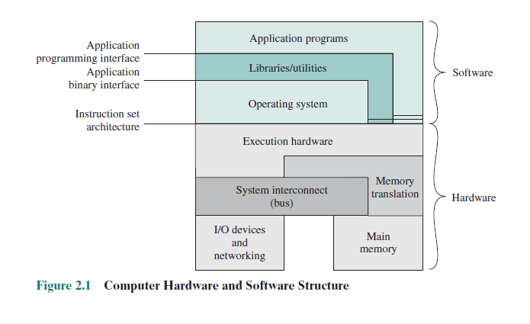
Computer Hardware and Software Structure

Slide 25
Operating System Services
Program Development
Program Execution
Access to I/O Devices
Controlled Access to Files
System Access
Error Detection and Response
System Accounting

Slide 26
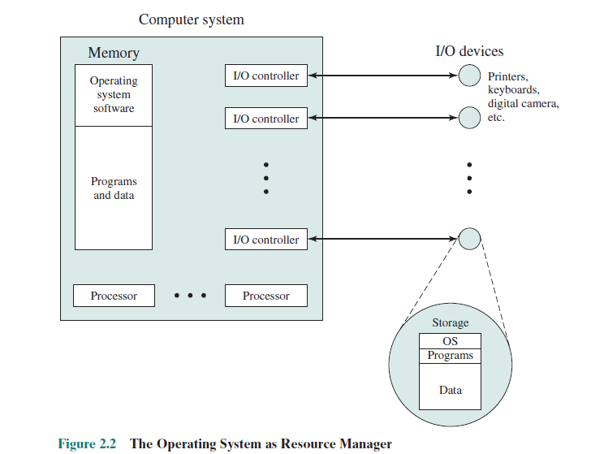
Operating System as Resource Manager

Slide 27
Evolution of Operating System
Serial Processing
Simple Batch System
Multi-programming
Time Sharing System
Multi-processor System

Slide 28
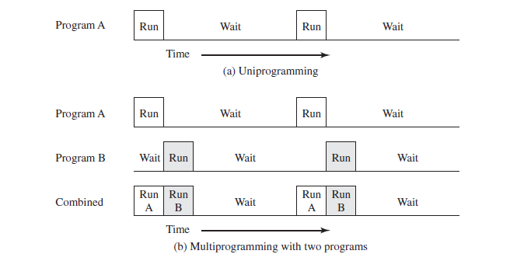
Multi-programming Exmple

Slide 29
Major Advances in development of Modern Operating System
Process
Memory Management
Protection and Security
Scheduling and Resource Management

Slide 30
System Calls
Programming interface to the services provided by the OS
Typically written in a high-level language (C or C++)
Mostly accessed by programs via a high-level Application Program Interface (API) rather than direct system call use
Three most common APIs are Win32 API for Windows, POSIX API for POSIX-based systems (including virtually all versions of UNIX, Linux, and Mac OS X), and Java API for the Java virtual machine (JVM)

Slide 31
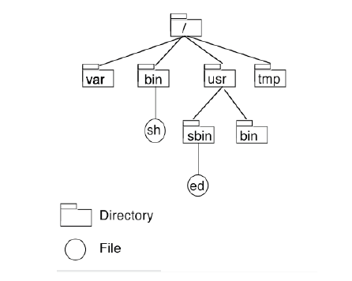
The Unix File System

Slide 32
The Unix File System
There are two ways to identify files in the file system.
• The first way is by specifying the absolute pathname.
• The absolute pathname is the path relative to the root of the file system. It represents the position of the object by specifying the path through the hierarchy
The other way of referencing a file in the file system is
by using a relative pathname.
• A relative pathname is not prefixed by a /. It signifies that file can be found relative to the current location of the user in the file system.
• At any time you will be positioned somewhere in the file system. This position is commonly referred to as current working directory.

Slide 33
Types of Objects in a File System
There are six basic file types.
Regular files.
Directories.
Links (including symbolic links).
Special Files.
Named Pipes.
Socket Files.

Slide 34
Regular File
A regular file in Unix may contain either ASCII
(American Standard Code for Information Interchange)
or binary data.
• In the event of binary data, the application that reads/
writes the file determines its format.
• A regular file will contain zero or more blocks on the
file system. However such a file will occupy ONLY one
inode.
• Some Operating Systems use extensions to interpret
the file.

Slide 35
Directory
Directories provide a mapping between the names of
files and the files themselves.
To us directories allow us to order our files (basis of hierarchy).
A directory is merely a file which contains a mapping of objects in it. It consumes an inode like everything else.

Slide 36
Special File
Special files contain no data, instead they are used to map a physical device or service to the file system.
There are two kinds of special files.
– Block Special.
These files are associated with block structured devices e.g. disks. Such devices transfer data to and from the computers memory in blocks
- Character Special.
These are devices which communicate using streams of characters. Examples are consoles, terminals and even printers.

Slide 37
Named Pipe
File management system is considered part of the operating system
Input to applications is by means of a file
Output is saved in a file for long-term storage

Slide 38
Softlinks and Hardlinks (1)
Hard Links are links between files ONLY on the same file system.
Remember a file system contains inodes and each file occupies one inode. Because the overall file system can be composed of smaller file system this means inode numbers are not unique in the entire file system.
In the case of a hard link, a inode is not consumed rather the creation of such a link consumes a directory entry.

Slide 39
Softlinks and Hardlinks (2)
Soft links however can span file systems. So it is possible to have a soft link point to a file on a different slice or disk (even via network).
Soft links are commonly referred to as symbolic links.
With a soft link a directory entry and new inode are allocated. The target files pathname is stored in the link.

Slide 40
References
Stallings, W. (2014). Operating Systems: Internals and Design Principles. 8^{th.} ISBN: 978-0-13-380591-8

